Slide 1

Address by Mr Ahmed Arbee Chairperson Africa Chapter
10th World Conference IARLJ –Tunis 22 October 2014

Slide 2
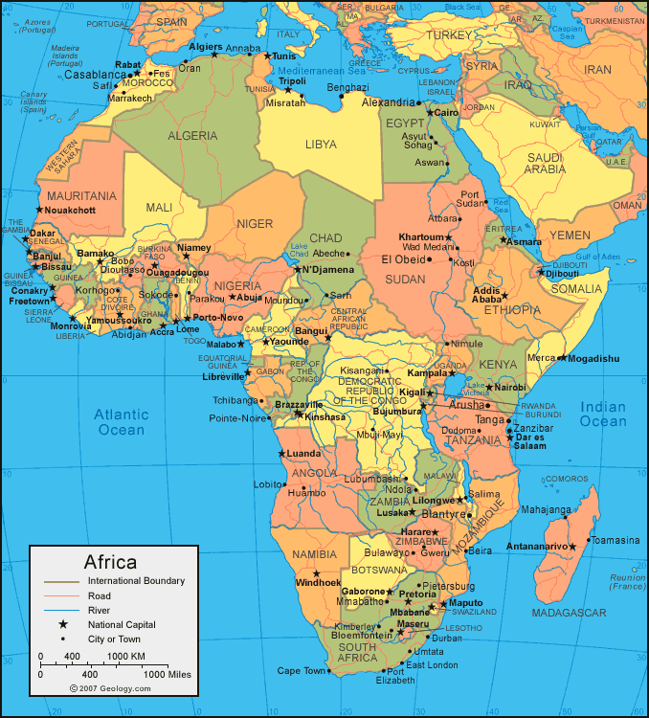

Slide 3
AFROCA S
AFRICA’S SIGNAL OF DESPAIR

Slide 4
Advancing Refugee Law around the World, Contemporary Challenges in Emergent and Established Asylum Systems.

Slide 5
I am indeed grateful to the International Association for Refugee Law Judges for this opportunity and I will cherish this honour for a very long time to come.
The aim of our Association is to promote a common understanding of Refugee Law so that all Asylum Seekers are treated equally before the law that is administered by most countries.
Where Judges and Decision Makers have a forum to discuss emerging jurisprudence, the risk of divergent interpretations are reduced substantially.
Our Association is committed to sharing its experience by assisting in establishing or improving Refugee Status Determination Systems around the world, harmonising policy and practice and providing valuable guidance when legislation is intended to be promulgated into Law .

Slide 6
It is this context that the 10th World Conference of the IARLJ hosted here in Tunis provides a unique platform for local judges to interact or engage directly with the International Judicial fraternity, hoping to generate greater awareness and developing a common vision when focusing on Refugee Law, International Human Rights Law and other relevant Conventions.
As we project our vision into the future it should come as no surprise that Africa continues to beam conflicting signals of hope and despair as articulated by the expressions as depicted on the screen.

Slide 8
At no time in the history of the African Continent including the Middle East have we witnessed such blatant levels of confrontation.

Slide 9
It is difficult to comprehend the appalling acts of violence, wanton destruction, indiscriminate bombings, the killings and expulsion of populations on a massive scale, calculated atrocities, the beheadings, terrorist attacks and rape have become a defining characteristic when we talk of contemporary challenges.
The proliferation of arms in conflict regions, the arming of opposition groups in support of regime change have resulted in chaos , conflict and mass displacement of innocent men, women and children. Increasingly we are observing that a number of these conflicts have more to do with a desire to control the oil fields, the wealth or resources of a Country. Libya, Iraq, Egypt, Sudan, South Sudan the DRC, CAR, Somalia and Syria are tragic examples and the list goes on and on. In these areas, sadly we observe that peace, justice and the rule of law remain elusive and a devalued currency confining people to live in Camps – their hopes and dreams shattered.

Slide 10
In analysing statistical trends, the UNHCR’s year end Statistics for 2005 recorded a total of 20.8 million persons being of concern to the UNHCR Office – the refugee total alone stood at some 8.4 million persons with women and children forming a significant majority.

Slide 11
Refugee population of selected countries of origin according to percentages of
disaggregated data | 2003 - 2012
Liberia | 1,350,400
Somalia | 5,402,900
Iraq | 9,834,200
Central African Republic | 1,066,700
Sudan | 5,279,900
Dem. Rep. of the Congo | 4,463,100
Burundi | 2,453,300
Eritrea | 1,529,300
Afghanistan | 24,719,800
Myanmar | 2,631,700
Angola | 1,637,000
Colombia | 1,919,800
Viet Nam | 2,325,200
All countries | 64,613,300

Slide 12
By the end of 2013, the population of concern to the UNHCR have reached levels unseen since the Rwanda Genocide of 1994, recording approximately 51.2 million persons who are forcibly displaced as a result of persecution, conflict, generalised violence and human rights violations.
Of the 51.2 million persons identified in 2013, 16.7 million persons were refugees (8.4 million) in 2005 (doubled) over 33 million persons internally displaced.
If there 51.2 million people were a nation, they would make up the 26th largest nation in the world.
If we analyse the proportion of refugees residing in developed regions versus developing regions, you will come to the disturbing conclusion that developing (poorer) nations host about 86% of the world’s refugees, the highest ever recorded.

Slide 13
If one considers the host countries who accommodate the most Refugees, they are in descending order: Pakistan, Iran, Lebanon, Jordan and in Africa, Kenya, Tanzania, Chad, Ethiopia, South Sudan, the DRC, Uganda and South Africa.

Slide 14
Population of host countries with 1 million cumulative refugees according to percentages of data | 2003 – 2012
Kenya 3,668,400 Jordan 2,727,200 Thailand 1,230,800 Yemen 1,385,900 Syrian Arab Republic 6,020,600 Ethiopia 1,562,300 Uganda 2,089,700 Chad 3,020,400 United Rep. of Tanzania 3,338,500 Pakistan 15,042,300

Slide 15
Egypt 1,010,700 Nepal 1,105,000 Zambia 1,052,100 Dem. Rep. of the Congo 1,754,300 Islamic Republic of Iran 9,824,000 Sudan 1,553,100 Algeria 1,093,900 China 2,105,000 Venezuela (Boliv. Rep. of) 1,102,800 Saudi Arabia 1,448,100 France 1,549,600

Slide 16
The 2013 levels of forced displacement were the highest since 1989.
These statistics will continue to haunt the conscience of all peace loving people of the world.
I think at times, we simply allow ourselves to live with this harsh reality not fully realising the magnitude of the trauma our fellow human beings are subjected to.
Trauma when in the midst of the violent confrontations- Trauma when leaving everything behind- even the dead- trauma when faced with exploitation during the hazardous journeys - even greater trauma when the receiving host nation also demonstrates a sense of carelessness when the applicants for Asylum are tossed around from pillar to post waiting endlessly in queues at the mercy of insensitive Officials willing to exploit the vulnerable.
This October we commemorate the tragic loss of some 366 refugees who drowned a year ago when they braved the Mediterranean and almost reached the Island of Lampedusa. Also twenty years ago we commemorate another tragic event, the genocide and ethnic cleansing of some 850,000 Tutsi Rwandan nationals.

Slide 17
Imagine the desperation in travelling in unseaworthy boats risking their life fleeing persecution.

Slide 18
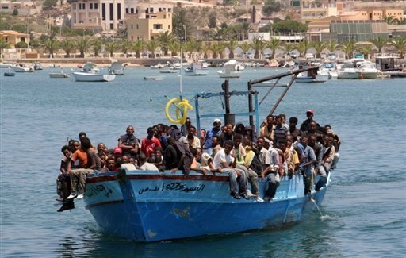

Slide 19
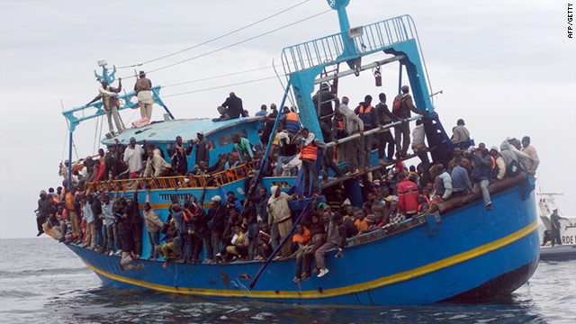

Slide 20
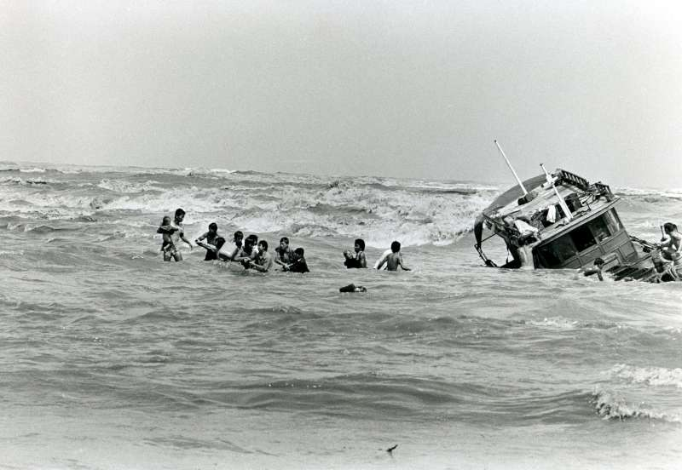

Slide 21
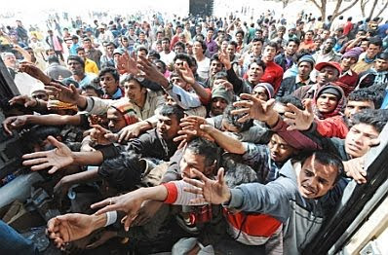

Slide 22
In Jim Hathaway’s publication under the title, “Reconceiving International Refugee Law,” he finds that most nations see little self interest in extending refugee protection. Instead he observes an alarming growth in the developed States in Europe, America and Australia calling it the politics of “non entry’- mechanisms to keep refugees from reaching a nation’s border, offshore processing and increasingly finds that refugee burdens are shifted from the wealthy countries of the north to the less developed nations in the South.
The fortress mentality of the so called “developed states” places a greater burden on Africa to host refugees, often placing pressure on internal resources of a country and leading to misunderstanding and resentment by citizens (perhaps best illustrated by the ongoing xenophobic attacks on foreign nationals in South Africa).

Slide 23
A similar observation was presented by Erika Feller, the Assistant High Commission – Protection (UNHCR) when she addressed our Association’s Conference in Mexico in 2006.
She stated that “while numbers remain deeply disturbing, equally of concern is the fact that the Asylum space has noticeably shrunk over recent years.”
This has made preserving access to and the quality of asylum quite a challenge.

Slide 24
Host countries may be overwhelmed by the sheer number of refugees seeking protection in their borders and their resources may be unable to provide adequately for people seeking asylum (especially when camp systems are utilised – which is the preferred method in most African host states.) It comes as no surprise that the encampment policy “restricts the freedom of movement of refugees and asylum-seekers and impedes their efforts to become self-reliant.” While an urban model may serve the purpose of encouraging refugees to become more self-sufficient, integration can be a struggle and the emergence of xenophobia may place refugees’ lives in danger within their host communities. The looting of foreign owned shops and violence directed at foreign nationals is a huge challenge in South Africa and, according to the UNHCR, similar factors have led to the deterioration of public and official support for asylum in Angola, Malawi and Mozambique.

Slide 25
While countries who opt for encampment of refugees do limit their free movement and their right to effectively work and deny them the opportunity to become integrated into the host community, an urban model is certainly not without challenges. Solomon Wasia Masitsa, a human rights lawyer from Kituo Cha Sheria, in Kenya, speaking at the 2013 Public Interest Law Gathering at Wits University in Johannesburg, South Africa, highlighted the struggles of encampment in Kenya. He mentioned poor living conditions inside the camps, corruption, bribery and police harassment. In 2012 Kituo Cha Sheria approached the Kenyan High Court and on 26 July 2013, Petition of 2013 of the Kenyan High Court ruled that a government plan to move approximately 55 000 refugees from Nairobi to camps was unlawful. The Court ruled that the plan would violate refugees’ dignity and their right to freedom of movement. “The court’s judgment is a welcome reprieve for Kenya’s 55,000 urban refugees and a reminder that the authorities can’t just walk all over refugees’ rights,” said Gerry Simpson, a senior refugee researcher at Human Rights Watch. “The court’s decision should send a strong message to the authorities that the recent violence and threats against Nairobi’s refugees should end.”

Slide 26
However, following upon the terrorist attack in a shopping Mall in Nairobi, the Government halted the registration of refugees in urban areas in Kenya and forcibly removed some 55.000 urban refugees confining the Somalian refugees to the Dadaab Refugee Camp and other nationalities assigned to the Kakuma camp.
If one considers South Africa as an example of the urban refugee model, once can see that a progressive legislative framework is hindered by implementation...
I need to draw your attention to statisics which reflect that South Africa is one of the countries receiving the highest number of refugees and irregular movers in the whole of the continent and, indeed, the world.
The graph that follow refects:

Slide 28
The statistics on refugee flows in South Africa clearly reflect that South Africa status determination systems are very much under pressure.
It may be appropriate for the IARLJ and the UNCHR to identify countries like South Africa with the view to promoting capacity building initiatives and improving the status determination procedures and decisions within the context of global responsibility sharing.

Slide 29
Apart from issues such as corruption and ineffective administration, opposition to local integration forms a barrier to the effective realisation of the rights of refugees to live within a host community and places the rights of safety and security of refugees in serious jeopardy.
At the Public Interest Law Gathering of 2013, held at Wits University, panellists discussed increasing xenophobic tensions in South Africa. Loren Landau, from Wits University African Centre for Migration and Society suggested that xenophobia was not a general attitude but specific to localised demographics. He mentioned that in many areas foreigners and locals integrated well but areas without structural institutions saw extreme cases of discrimination against foreigners. He spoke of a mob mentality which develops and foreigners with legal status are treated no differently to those perceived as “illegal immigrants”.
The situation is exacerbated by a lack of adequate conflict resolution mechanisms and a mistrust and fear of the police. Alfani Yoyo from CORMSA said (at the same Public Interest Law Gathering) that local integration could be improved by workshops with locals and refugees as well as an improvement in the police’s capacity to respond to outbreaks of xenophobia.

Slide 30
Against the background of the tightening of legislation in the refugee protection arena in many states, the role of the judiciary is to ensure adherence to International and Regional human rights instruments as well as to hold lawmakers and governments accountable for compliance to fundamental principles such as non-refoulement and the respect for basic human rights and dignity. The closure of Refugee Reception Offices in South Africa (and the government’s non-compliance with Court orders declaring the closures unlawful) demonstrates a crisis of legality which places the refugee protection system under further strain. Protection of refugees’ rights comes under serious threat when government does not heed the rulings of Courts.
An independent judiciary can only be effective in a state which enjoys basic freedoms such as rule of law, freedom of expression and accountability. It is therefore important to consider whether the region may be considered “free enough” for the actions of the judiciary to be considered influential. An independent judiciary is indispensable in any democracy.

Slide 31
Freedom House has the following to say about the Middle East and North Africa:
“The Arab Spring of 2011 launched an era of sweeping political changes in the countries of the Middle East and North Africa, which has historically been the least free region in the world. The fall of long-time leaders and the people's rising demands for a stronger voice in their own governance have brought new opportunities for reform and democratic transition in countries otherwise marked by severe abuses of almost all fundamental political rights and civil liberties.”
Despite this, the Middle East and North Africa (which includes 21 countries or territories and is home to an estimated 405 million people) has a freedom ranking of only “2%” and the freedom of the press is also only described as “2% free” by Freedom House.
Therefore the role of the judiciary can be bolstered only if the freedom of states is protected - specifically the rule of law, freedom of expression and the independence of the judiciary. The rule of law protects the rule of life.
In conclusion Mr President, we wish the People of Tunisia well in the elections. After independence from French Colonial rule in 1956, two successive Presidents virtually left a legacy of dictatorial control with a poor track record of promoting basic human rights.

